Slide 1

Interstate compact on the placement of children (icpc)
A binding agreement adopted by all 50 states, the District of Columbia, and the US Virgin Islands.
Provides legal and financial protection to children placed out of state.
Ensures safety of the placement prior to the move and continued monitoring after.
ORS 417.010 – 417.990
OAR 413-040-0200 – OAR 413-040-330

Slide 2
10 Articles
ORS 417.010 – 417.080
Purpose & Policy
Definitions
Conditions for placement
Penalty for illegal placement
Retention of Jurisdiction
Institutional Care of Delinquent Children
Compact Administrator
Limitations
Enactment and Withdrawal
Construction and Severability
Define the types of placements to which ICPC applies
Specify the procedures to be followed when placing a child in another state.
Specify the protections, services and requirements of the ICPC

Slide 3
12 Regulations promulgated by the
Association of Adminstrators of the Interstate Compact
on the Placement of Children (AAICP)
Relocation of Family Units
Public Court Jurisdiction Cases: Placements for Public Adoption or Foster Care in Family Settings and/or with Parents/Relatives
Definitions and Placement Categories: Applicability and Exemptions
Residential Placement
Central State Compact Office
Permission to Place Child: Time Limitations, Reapplication
Expedited Placement Decision
Change of Placement Purpose
Definition of a Visit
Guardians
Responsibility of States to Supervise Children
Private/Independent Adoptions

Slide 4
Regulation 1: Applies when already approved placement (ie. certified foster home) resource wishes to move out of state with the child.
Regulation 2: Applies when Child is within the jurisdiction of the Court and/or in the custody of an agency, such as DHS, and the agency seeks to place the child in another state.
Regulation 3: Defines placement categories to which ICPC applies and exemptions.
1. Adoptions: Placement preliminary to an adoption (independent, private or public adoptions)
2. Licensed or approved foster homes (placement with related or unrelated caregivers)
3. Placements with parents and relatives when a parent or relative is not making the placement as defined in Article VIII (a) "Limitations“***
4. Group homes/residential placement of all children, including adjudicated delinquents in institutions in other states as defined in Article VI and Regulation No. 4.
***State’s are split regarding applicability of ICPC to placement with a parent. Oregon’s view: ICPC applies to placement with a parent. State ex rel. Juvenile Dept. of Clackamas County v. Smith, 107 Or. App. 129, 811 P.2d 145 (1991)

Slide 5
Regulation 3 does allow the court to place a
child with a parent without going through
ICPC, provided that:
Child was not removed from that parent; and
The court has no evidence before it, and seeks no evidence, that the parent is unfit; and
The court dismisses its jurisdiction immediately.
Receiving state will have no supervision or monitoring responsibility

Slide 6
Regulation 7 – priority placement
Proposed placement is with:
    Parent
    Step-parent
    Grandparent
    Adult uncle or aunt
    Adult sibling, or
    Legal guardian
The case meets at least one of the following criteria:
Unexpected dependency due to recent incarceration, incapacitation, or death of a parent or guardian, or
The child is under 4 years of age, or
The court finds that any child in the sibling group to be placed has a substantial relationship with the proposed placement, or
The child is currently in an emergency placement.
AND

Slide 7

REGULATION 7 (CONTINUED)
The receiving state is expected to approve or deny placement within 20 business days.
The child cannot be in the home while a Reg 7 study is being completed.
Some states are not able to comply with Regulation 7 timelines. (i.e. Washington and California)

Slide 8
Court order with specific findings is required to initiate expedited ICPC. Form CF101 located on DHS website:
http://www.dhs.state.or.us/policy/childwelfare/icpc_tools.html

Slide 9
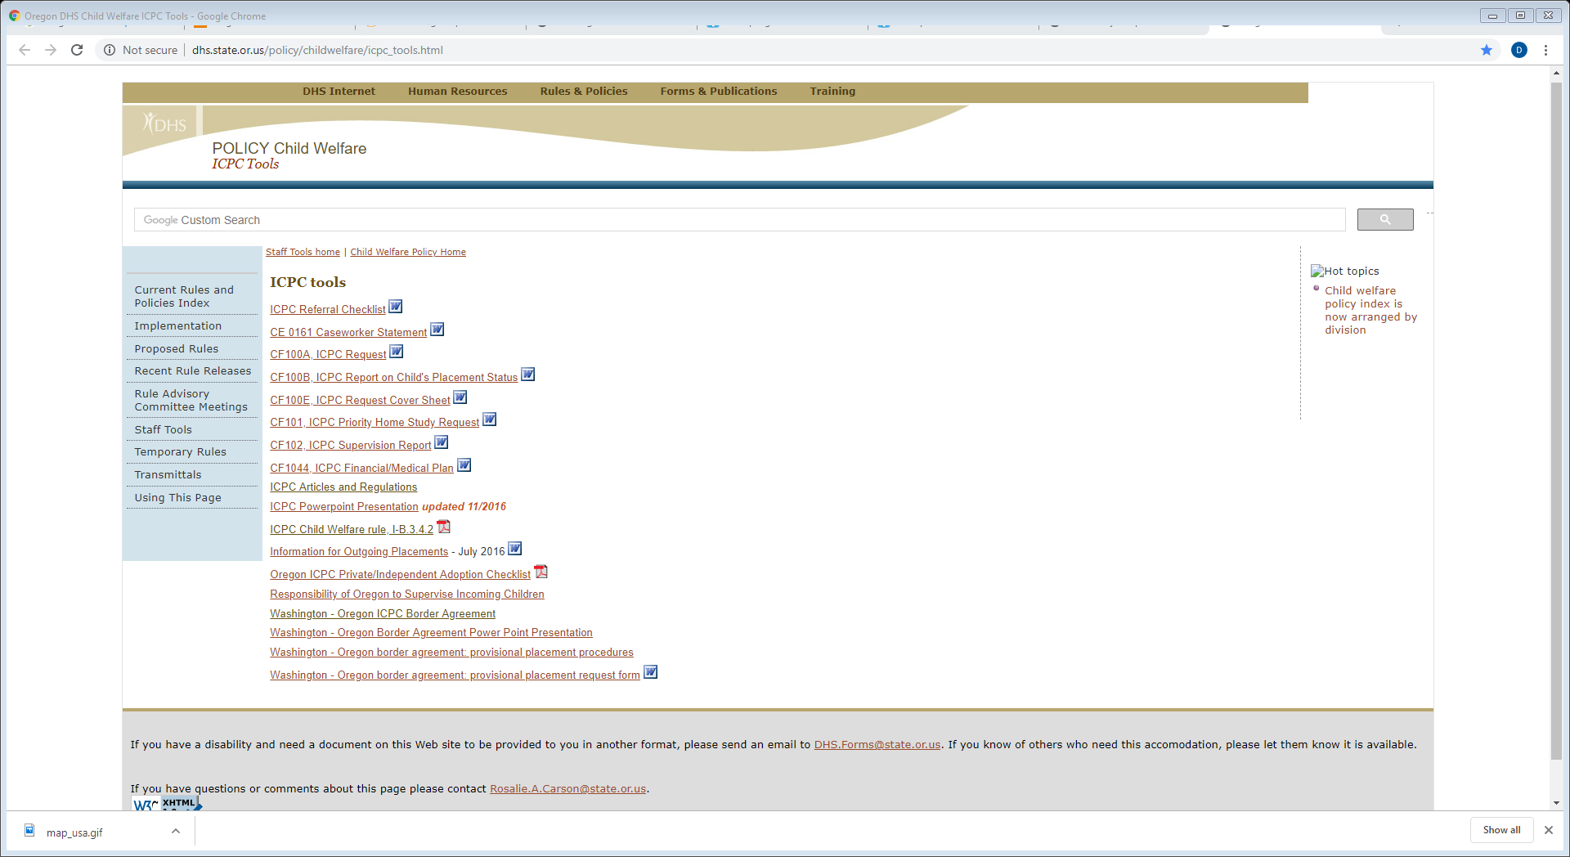

Slide 10
Visits - ICPC Regulation 9
A child traveling out of state is considered to be on a visit when:
It is for a brief social or cultural experience; and
The visit has a definite end date; and
The visit is no longer than 30 days, or begins and ends within a school vacation; and
There has been no request for a home study or supervision.
ICPC is not required for visits.
Per Article 1, any request for a home study creates a rebuttable presumption that it is a “placement” rather than a visit. If a home study is in process and a genuine visit is planned, receiving state needs to be notified in advance.

Slide 11
Important to Remember:
No placement may occur prior to approval from receiving state’s ICPC office.
Court must maintain jurisdiction until appropriate authority in receiving state agrees in writing. (Article 5)
Cannot circumvent ICPC by appointing guardian. Department of Human Services v. A.B., 286 Or. App. 578 (2017) and State ex. Rel. Juvenile Dept. of Curry County v. Campbell, 178 Or. App. 271 (2001)

Slide 12
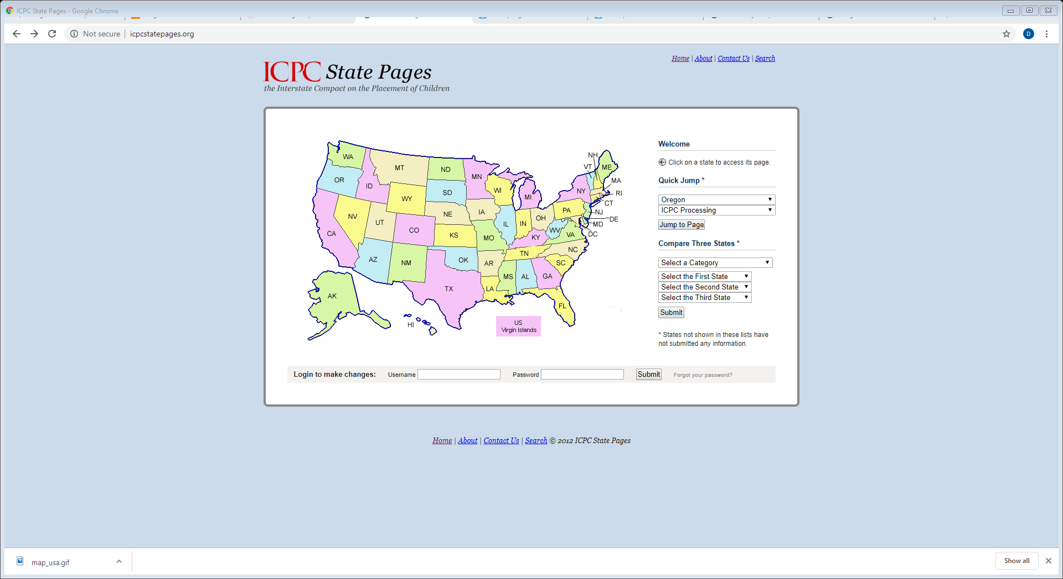

Slide 13
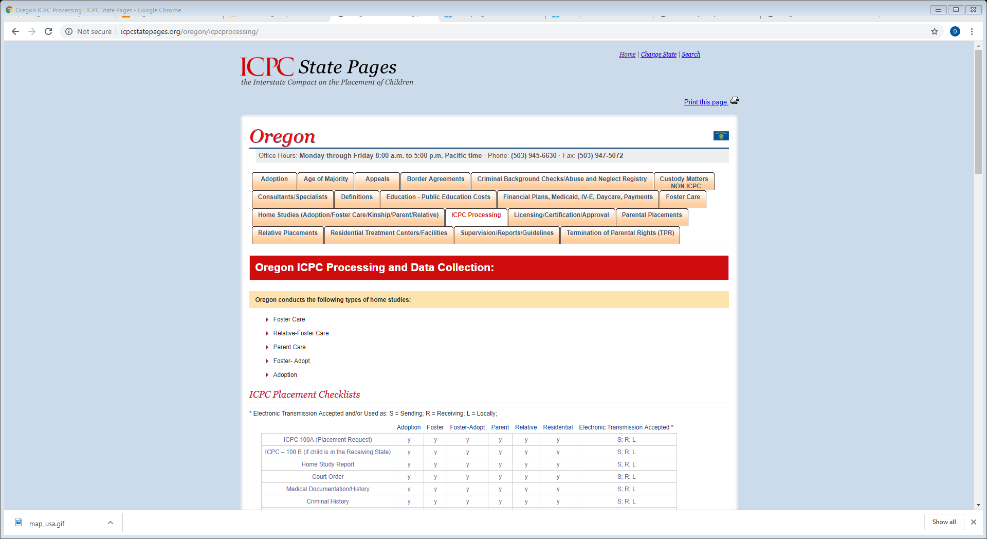

Slide 14
Prior to ICPC placement, a home study (including criminal background and CPS history checks) must be completed in the receiving state, and placement approval from the receiving state’s ICPC office must be obtained
Federal law requires interstate home studies to be completed within 60 days.
Placement must be made within 6 months of approval.

Slide 15
Oregon has a “Border Agreements” with Washington and Idaho which can be used in a limited number of cases to obtain “provisional placement” approval within 7 working days.
Only certain counties are eligible to use.
Washington Placement must be made within 20 calendar days of approval.
ICPC continues to apply. Full home study process will still be necessary in order for placement to receive final full approval.
Proposed placement must be with a relative or with a person “with whom the child has an established relationship and with whom the child has spent a substantial amount of time.”
Children must be in the legal custody of DHS.
Children cannot be physically residing in the home of the prospective placement family (including “visits”) at any time unless and until the placement is approved in writing according to the terms of the border agreement.

Slide 16
Counties eligible to use the agreement
In Washington: Benton, Clark, Cowlitz, Franklin, Pacific, Wahiakum, Walla Walla, Skamania and Klickitat
In Oregon: Clackamas, Clatsop, Columbia, Morrow, Multnomah,Umatilla, Washington, Sherman, Gilliam, Wasco and Hood River
**Idaho Agreement only applies to Malheur and Payette Counties and is limited to 10 cases per year

Slide 17
CONFERENCE OF CHIEF JUSTICES
CONFERENCE OF STATE COURT ADMINSTRATORS
Resolution 3
In Support of Increased Judicial Involvement to Expedite Movement of Children Under the Interstate Compact on the Placement of Children
WHEREAS, the Conference of Chief Justices and the Conference of State Court Administrators understand the need to expedite the placement of abused and neglected children in safe and permanent homes, and that in some cases the best placement is in another state, which requires interstate cooperation and collaboration; and
WHEREAS, the Interstate Compact for the Placement of Children (ICPC) provides the structure for interstate cooperation and collaboration for these placements; and
WHEREAS, in recent years, efforts have been made to update the ICPC and improve the ICPC process to ensure compliance with federally mandated permanency planning timeframes, including passage of the Safe and Timely Interstate Placement of Foster Children Act of 2006 (Public Law 109-239); and
WHEREAS, despite these efforts, unreasonable delays continue to impede the placement of abused and neglected children in safe and permanent homes; and
WHEREAS, state courts in sending states have been unable to effectively intervene with the receiving state or county agencies or state ICPC offices to determine the causes for delay or possible solutions;
NOW, THEREFORE, BE IT RESOLVED that the Conference of Chief Justices and the Conference of State Court Administrators encourage all states and jurisdictions subject to the ICPC to adopt legislation that authorizes judges in sending and receiving states and jurisdictions to communicate with one another regarding the placement of children; and
BE IT FURTHER RESOLVED that the Conferences encourage all states and jurisdictions subject to the ICPC to adopt legislation that authorizes judges in the receiving state or jurisdiction where placement is sought to hold hearings at the request of judges in sending states or jurisdictions on the status of ICPC home study requests and enter orders to complete those home studies when they are delayed and timely decisions are not made concerning the children involved.
Adopted as proposed by the CCJ/COSCA Courts, Children, and Families Committee at the 2013 Annual Meeting on July 31, 2013.Adopted

Slide 18
ICPC Manager: Vera James MSW, MPH
503-945-6685
ICPC Office
500 Summer St. NE, #E-70
Salem, OR 97301
Fax 503-947-5072
E-mail: oregon.icpc@state.or.us
Case assignments are based on the oldest child’s last name:
A – E Amanda Kramer, 503-945-5673, amanda.m.kramer@state.or.us
F – K Marcy Stenerson, 503-945-6260, marcy.m.stenerson@state.or.us
L – Q Lillie Axen, 503-945-5671, lillian.e.axen@state.or.us
R – Z Margie Salazar, 503-947-1108, margarita.s.salazar@state.or.us
Terrie Anderson (working Mondays and Tuesdays)

Slide 19

ICPC Process
Caseworker sends referral to ICPC office
ICPC office reviews
packet and sends it to
receiving state
Receiving state completes
home study and approves or denies
placement, then sends
decision back to
sending state ICPC office.
ICPC office documents
placement decision and
informs case worker.

Slide 20
Why is the ICPC needed?
Protects the child:
Legal and financial protections
Ensures safety of the placement prior to the move
Ensures continued monitoring after placement

Slide 21
ICPC Timelines
ICPC Regulation 7: 20 business days for placement decision
  Most states can’t meet this deadline due to foster certification requirements.
Safe and Timely Act: 60 days for a report on the home study
  The law does not require a placement decision by the deadline, so usually a preliminary report is provided.
ICPC Regulation 2: 6 months to provide final decision
Approval expires 6 months from the date the 100A was signed by the receiving state ICPC office

Slide 22
Why does ICPC take so long?
Varies by state
Licensing/certification requirements
  Completion of training
  Criminal history
Heavy caseloads
ICPC cases given lower priority
Proposed placement resources may be slow in following through
Request lost or never received by the receiving state.

Slide 23
Strategies to speed up the ICPC process
Check in with case worker on a regular basis.
Encourage prospective placement resource to follow through with all required activities in a timely manner.
The prospective placement resource can contact their state ICPC office to check status along the way. The resource can advocate for the home study request to be processed quickly and for the final placement decision to be transmitted promptly to the sending state.
The proposed placement resource also can contact their local child welfare office to request status.

